Slide 1
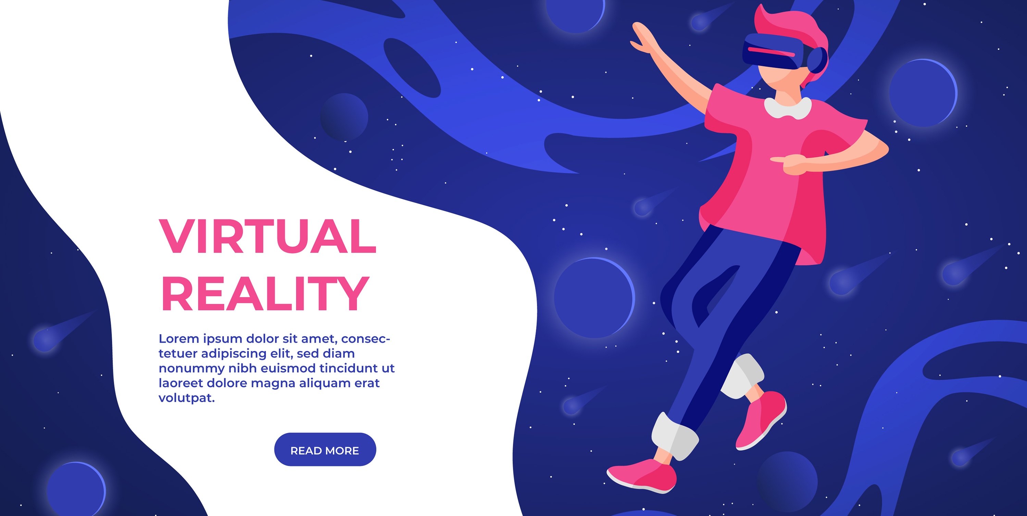
TEAM
GRIKEN

Slide 2
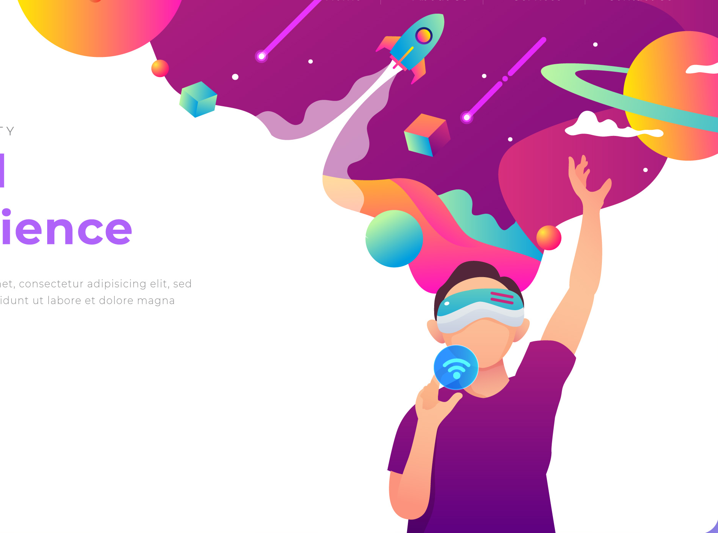
E-LEARNING
A CHALLENGE
E-learning is a growing sector and with the technological advancements, it is becoming more accessible, but students lack motivation to learn due to less interactive and traditional way of teaching.

Slide 3
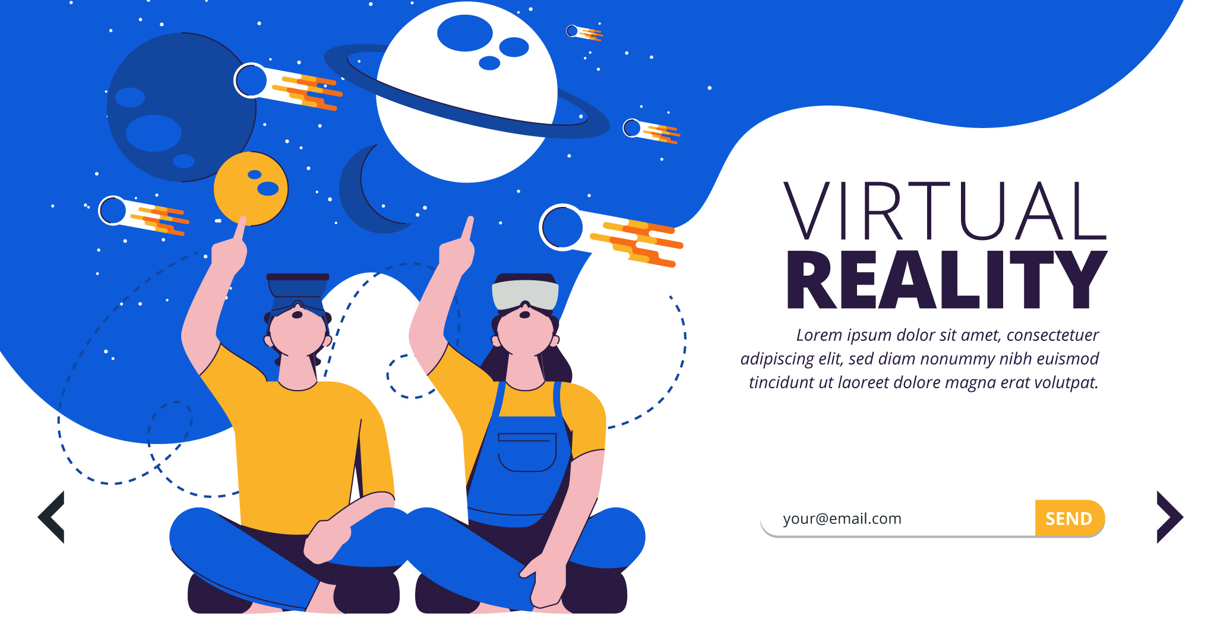
LET STUDENTS
EXPLORE NEW CLASSROOM
We plan to bring an interactive learning environment with the help of virtual reality environment. This will not only help students understand the concepts interactively, but in real time with accurate results in a fun way.

Slide 4
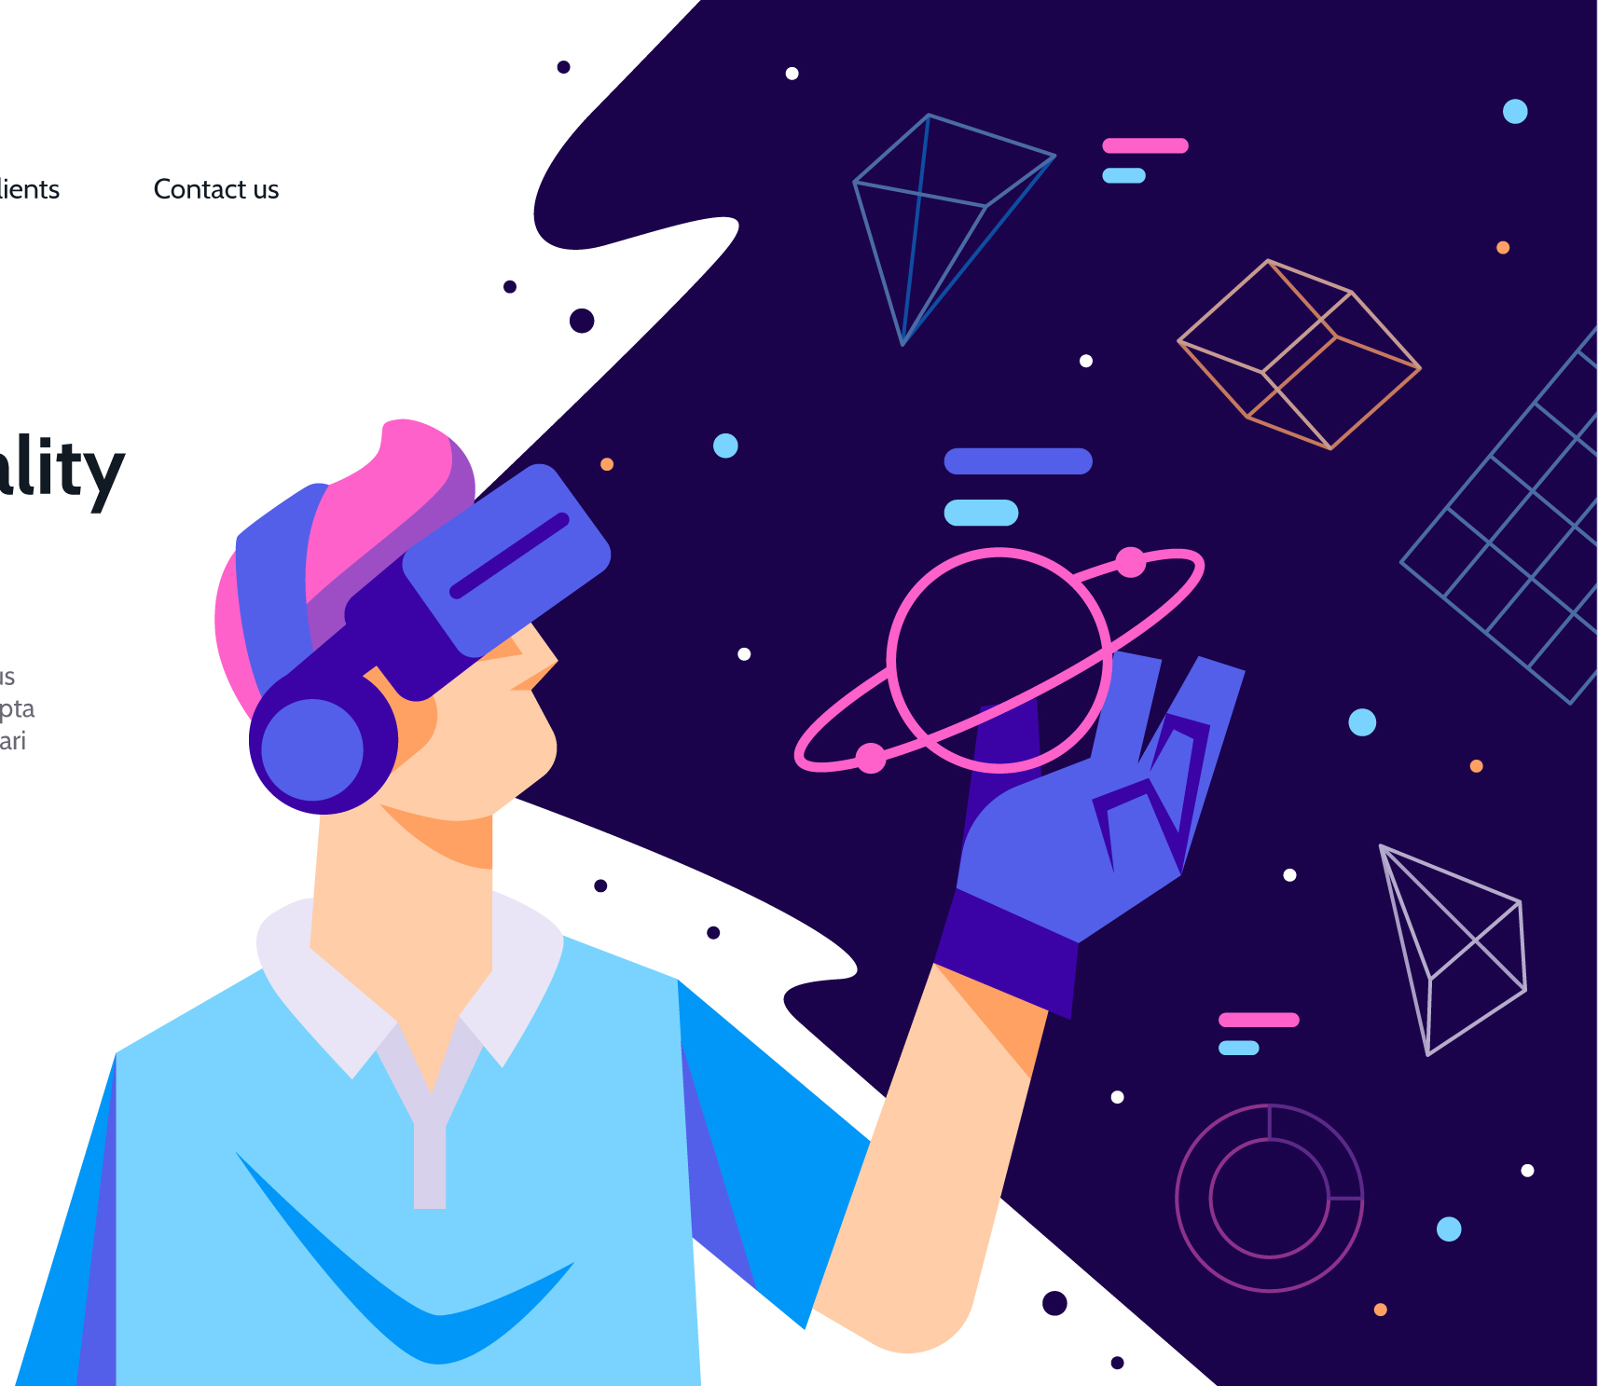
Application features
3D Virtual classrooms for
Educational purposes
Multi-platform support for non-VR devices
Digital courses
Practical labs and workshops
Multiplayer support to create a real-life environment
Real-time AI support for doubt solving and FAQs

Slide 5
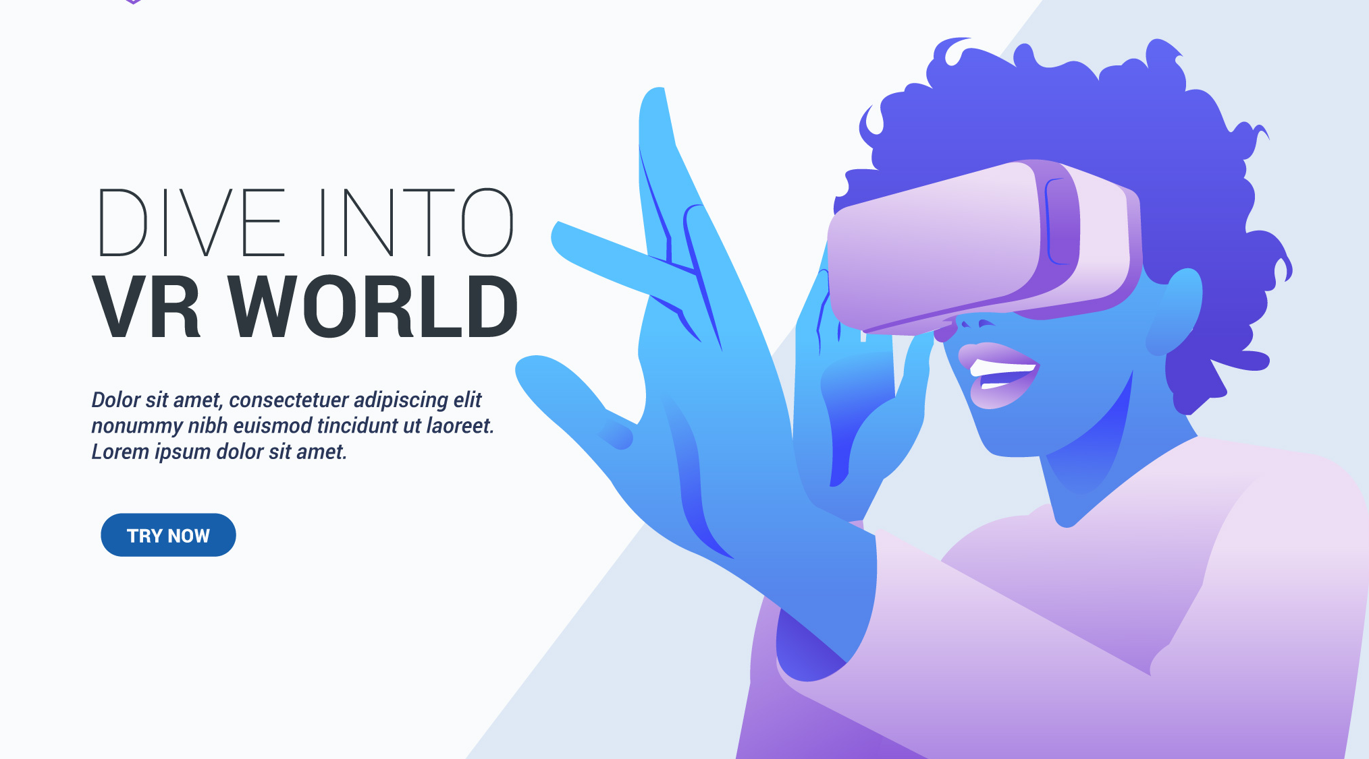
Virtual Labs and Workshops
With the help of VR, we will be able to implement Virtual Laboratory environments in different fields that may not be possible to perform in real life.
Having virtual simulation will help create a stabilized environment for experiments with in-depth view that might not be possible in real life .

Slide 6
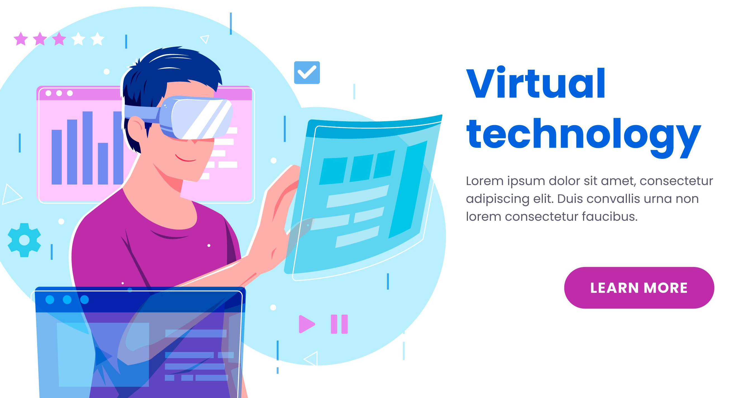
Unreal Engine 4
UE4 will be used for development of application, based around the client-server model the software will provide us with Institute dedicated servers which can run heedlessly for different institutes.

Slide 7
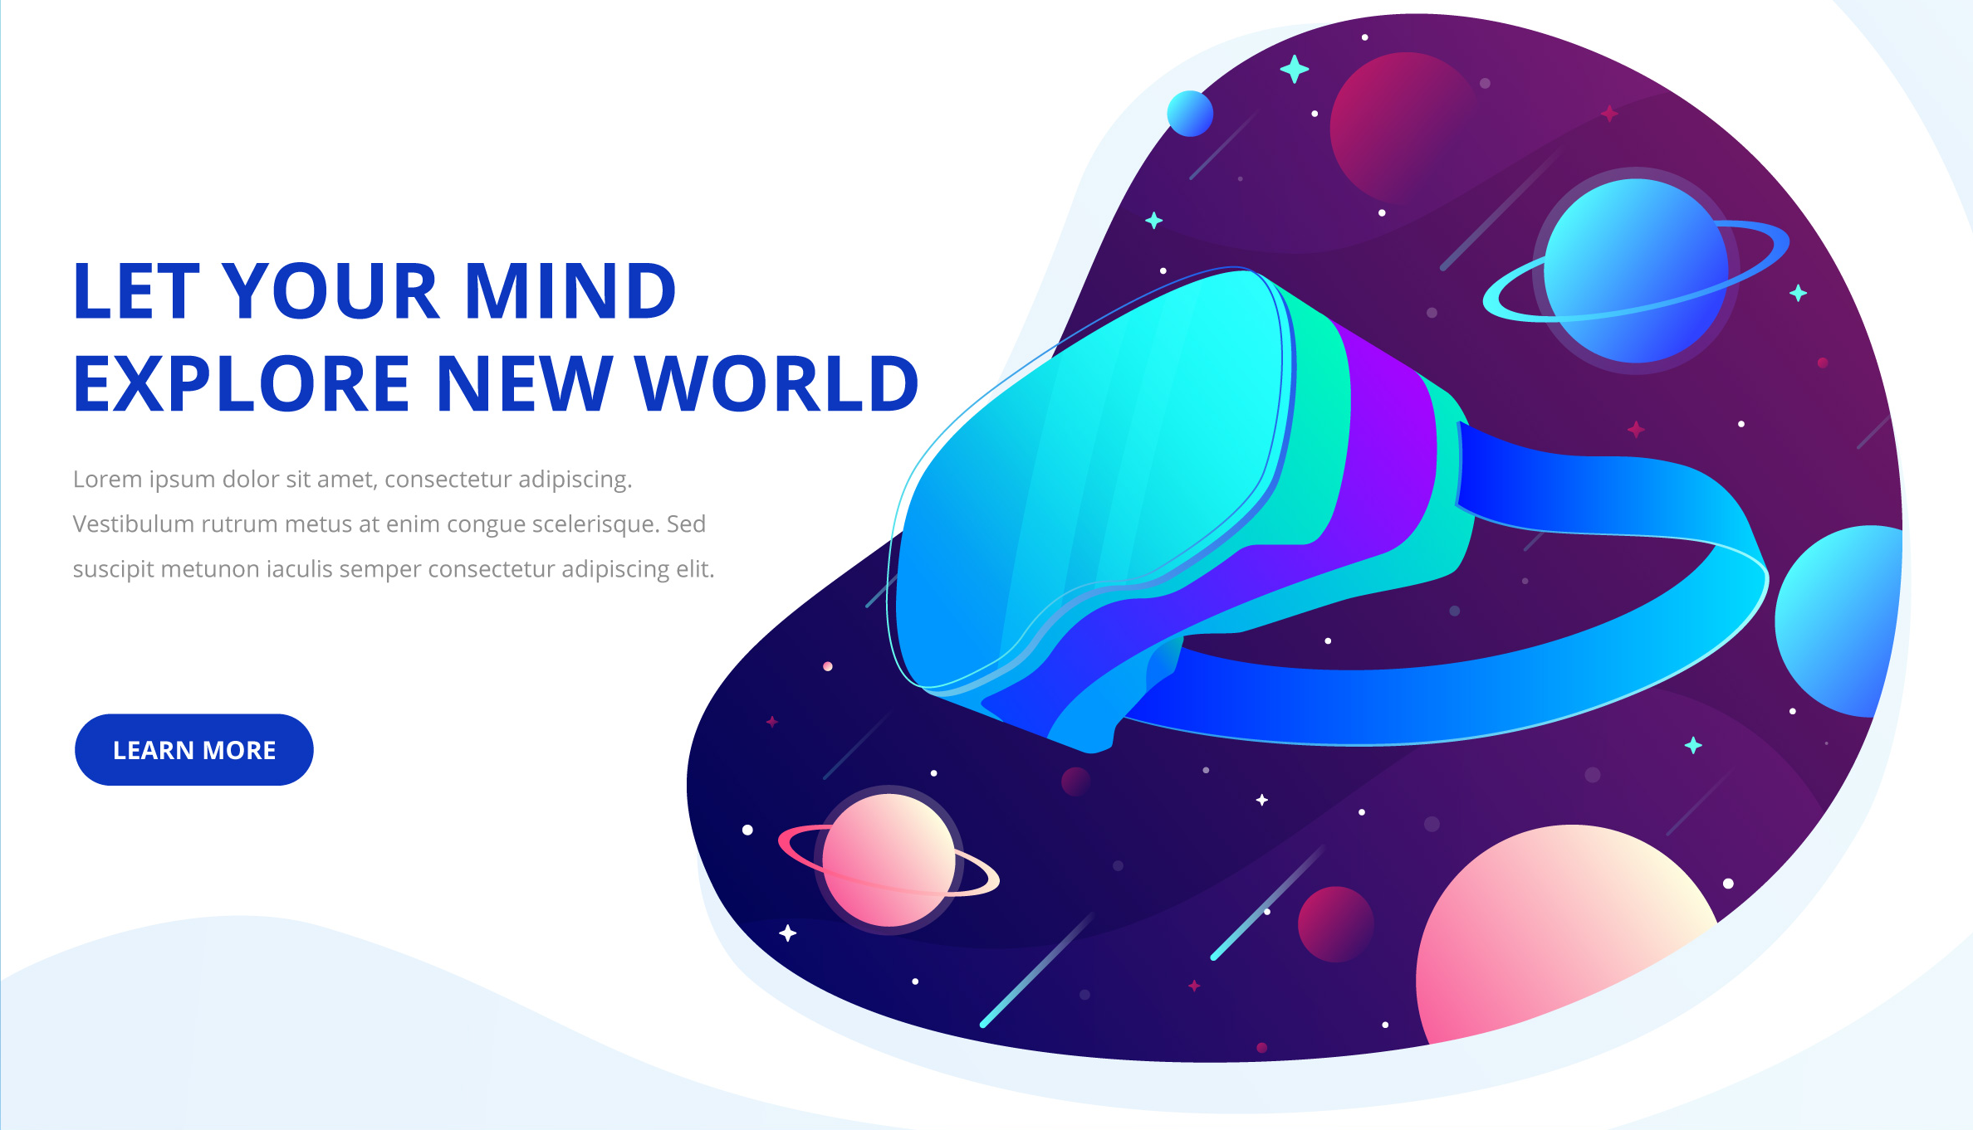

THANK YOU
UJJWAL SOLANKI
DIPENDRA SHARMA
TANMAY AGRAWAL
ADARSH SENGAR

